Slide 1
Design Pattern
Cefalo School

Slide 2
Motivation
Want to augment existing functionality
Do not want to alter existing code ( OCP)
Want to keep new functionality separate (SRP)

Slide 3
Design
Inheritance based
Utilizes composition and inheritance (is-a, has-a)
Alternative to sub classing
Constructor requires instance from hiearchy

Slide 4
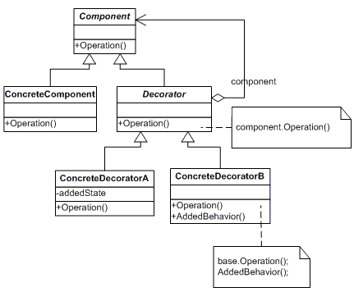
UML Diagram

Slide 5
Example
Validation of Phone number - Phone Number itself number i.e. Number Validator - Range Validator i.e. 11 digit

Slide 6
Lets see some code

Slide 7
Drawbacks
New class for every feature added
Multiple little objects
Often confused with simple inheritance

Slide 8
Contrast
Composite
Decorator
Tree structure
Leaf and composite have same interface
Unity between objects
Contains another entity
Modifies behavior
Doesn’t change underlying object

Slide 9
Assignment
Geometric Shapes
Point, Line, Rectangle
Validation
Draw

Slide 10
References
https://github.com/rezaulsajib/decorator
http://www.dofactory.com/javascript/decorator-design-pattern
http://www.dofactory.com/net/decorator-design-pattern
http://www.apress.com/in/book/9781590599082 (Chapter 12)

